Slide 1
Subject:
Object-oriented analysis and design
Chapter 2: Unified Modeling Language
Lê Văn Vinh, PhD
Department of Software Engineering
Faculty of Information Technology
HCMC University of Technology and Education

Slide 2
Contents
I.
UML overview
II.
Some basic concepts
III.
UML model views

Slide 3
Reading the book:
Software_Engineering_Using_UML_Patterns_and_Java, Chapter 3

Slide 4
What is the UML?
  UML stands for Unified Modeling Language
  The UML combines the best of the best from:
    Data Modeling concepts (Entity Relationship Diagrams)
    Business Modeling (Work Flow)
    Object Modeling
    Component Modeling
  The UML is a standard language for specifying, visualizing, documenting and constructing the artifacts of a software-intensive system
  It can be used with all processes, throughout the development life cycle, and across different implementation technologies

Slide 5
UML Heritage
General-purpose OO modeling language
  Convergence of a number of popular
  OO methods
UML
2.0
OMT
(Rumbaugh et al.)
UML
1.4
1996
Mar. 1999
Booch
UML
0.9
UML
1.1
Nov. 1997
OOSE
(Jacobson et al.)
Catalysis
ROOM
etc.

Slide 6
UML Heritage
  The Unified Modeling Language (UML) has been formally under development since 1994
  Managed by OMG (Object Management Group)
  Amongst the most popular designing languages in the market. Around 70% coverage)

Slide 7

UML Heritage
Contributions to the UML
Harel
Meyer
Gamma, et al
Statecharts
Before and after
conditions
Frameworks and patterns,
HP Fusion
Booch
Operation descriptions and
message numbering
Booch method
Rumbaugh
Embley
OMT
Singleton classes and
high-level view
Jacobson
Wirfs-Brock
OOSE
Responsibilities
Shlaer - Mellor
Odell
Object lifecycles
Classification

Slide 8
Goals of UML
  Enable the modeling of systems (not just software) using object-oriented concepts
  Establish an explicit coupling to conceptual as well as executable artifacts
  Address the issues of scale inherent in complex, mission-critical systems
  Create a modeling language usable by both humans and machines

Slide 9
UML Usage
  The UML may be used to:
    Represent the Elements of a system or a domain and their Relationships in a Static Structure using class and object diagrams
    Model the Behavior of objects with state transition diagrams
    Reveal the Physical Implementation Architecture with component & deployment diagrams
    Display the Boundary of a System & its major Functions using use cases and actors
    Illustrate Use Case Realizations with interaction diagrams

Slide 10
Contents
I.
UML overview
II.
Some basic concepts
III.
UML model views

Slide 11
Attributes
The data/static structure aspect of a class is represented by its attributes
Attributes may be found by examining class definitions, the problem requirements, and by applying domain knowledge
CourseOffering
Each course offering
has a number, location
and time
number
location
time
Notes:
27

Slide 12
Operations
The behavior of a class is represented by its operations
Operations may be found by examining interaction diagrams
registration
registration
form
manager
RegistrationManager
addCourse(joe, math 01)
addCourse(Student,Course)
Notes:
26

Slide 13
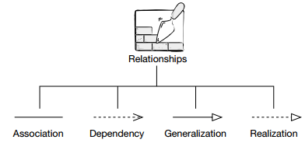
Relationships
  Relationships provide a pathway for communication between objects
Copyright © 1997 by Rational Software Corporation
Notes:
29

Slide 14
Contents
I.
UML overview
II.
Some basic concepts
III.
UML model views

Slide 15

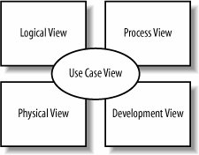
The 4 + 1 view

Slide 16
The 4 + 1 view
  Logical view: Class diagram, Object diagram, communication diagram, Collaboration diagram (UML 1.4), Sequence diagram.
  Development view: Component diagram, Package diagram.
  Process view: Activity diagram.
  Physical view: Development diagram.
  Use case view: Use case diagram

Slide 17
Models and Diagrams
A model is a complete
description of a system
from a particular
perspective
State
Diagrams
State
Diagrams
Class
Diagrams
Use Case
Diagrams
Use Case
Diagrams
State
Diagrams
Use Case
Diagrams
Use Case
Diagrams
State
Diagrams
Use Case
Diagrams
Object
Diagrams
Sequence
Diagrams
Scenario
Diagrams
State
Diagrams
Scenario
Diagrams
State
Diagrams
Communication
Diagrams
Component
Diagrams
Models
Scenario
Diagrams
Component
Diagrams
Scenario
Diagrams
Component
Diagrams
Statechart
Diagrams
Deployment
Diagrams
Activity
Diagrams

Slide 18
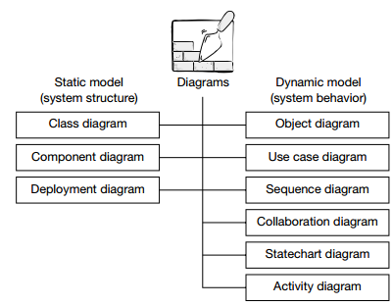

Slide 19
UML Model Views
  Requirements (use case diagrams)
  Static structure (class diagrams)
    kinds of objects and their relationships
  Dynamic behavior (state machines)
    possible life histories of an object
  Interactive behavior (activity, sequence, and collaboration diagrams)
    flow of control among objects to achieve system-level behavior
  Physical implementation structures (component and deployment diagrams)
    software modules and deployment on physical nodes

Slide 20
Diagrams
  A diagram is a view into a model
    Presented from the aspect of a particular stakeholder (client)
    Provides a partial representation of the system
    Is semantically consistent with other views
  In the UML, there are nine standard diagrams
    Static views: use case, class, object, component, deployment
    Dynamic views: sequence, collaboration, statechart, activity

Slide 21
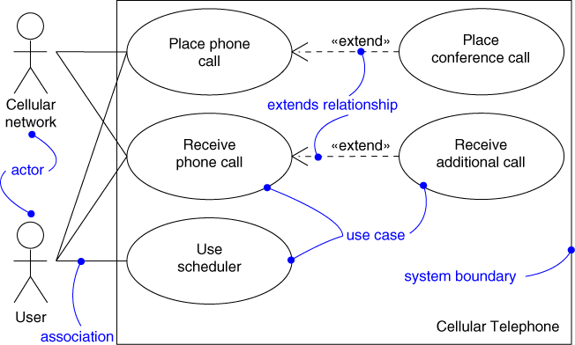
Use Case Diagram
Captures system functionality as seen by users

Slide 22
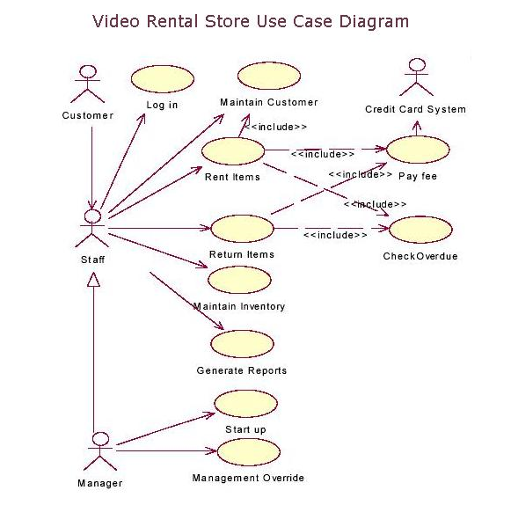
Use Case Diagram

Slide 23
Use Case Diagram
Captures system functionality as seen by users
Built in early stages of development
Purpose
  Specify the context of a system
  Capture the requirements of a system
  Drive implementation and generate test cases
Developed by analysts and domain experts

Slide 24
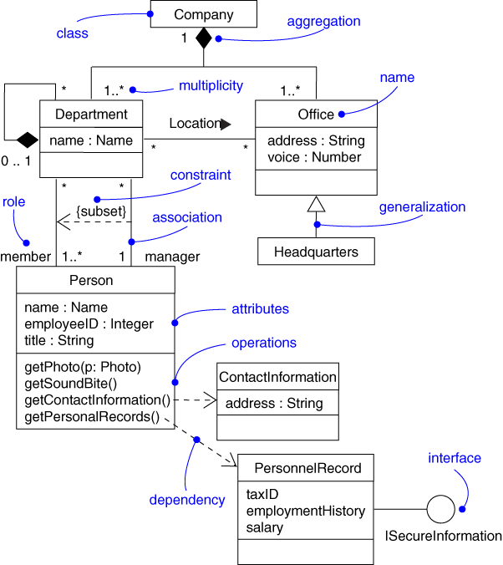
Class Diagram
Captures the vocabulary of a system

Slide 25
Class Diagram
Captures the vocabulary of a system
Built and refined throughout development
Purpose
  Name and model concepts in the system
  Specify collaborations
  Specify logical database schemas
Developed by analysts, designers, and implementers

Slide 26
Class Diagram: Example
Shows the entities in a system and their general relationships
client
creditor
Financial
Institution
Person
0..*
0..*
owner
0..*
generalization
association
Bank
Trust
Company
residence
0..*
House

Slide 27
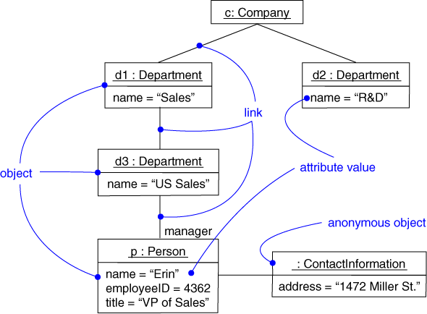
Object Diagram
Captures instances and links

Slide 28
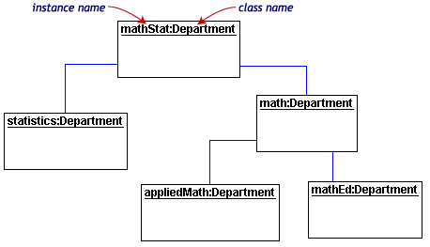
Object Diagram
Captures instances and links

Slide 29
Object Diagram
Shows instances and links
Built during analysis and design
Purpose
  Illustrate data/object structures
Developed by analysts, designers, and implementers

Slide 30
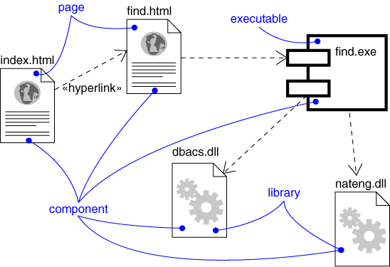
Component Diagram
Captures the physical structure of the implementation

Slide 31
Component Diagram
Captures the physical structure of the implementation
Built as part of architectural specification
Purpose
  Organize source code
  Construct an executable release
  Specify a physical database
Developed by architects and programmers

Slide 32
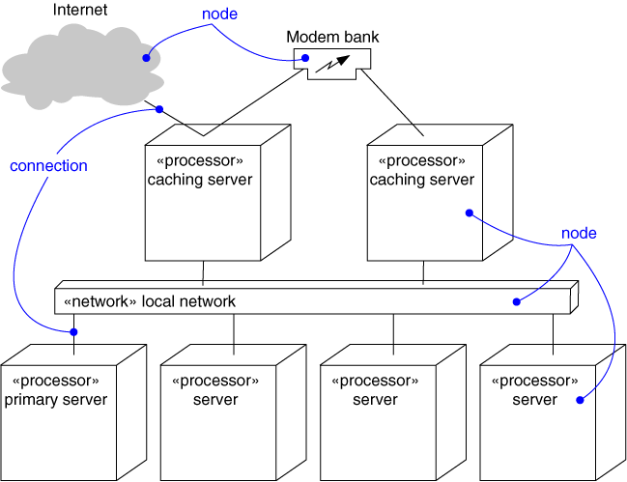
Deployment Diagram
Captures the topology of a system’s hardware

Slide 33
Deployment Diagram
Captures the topology of a system’s hardware
Built as part of architectural specification
Purpose
  Specify the distribution of components
  Identify performance bottlenecks
Developed by architects, networking engineers, and system engineers

Slide 34
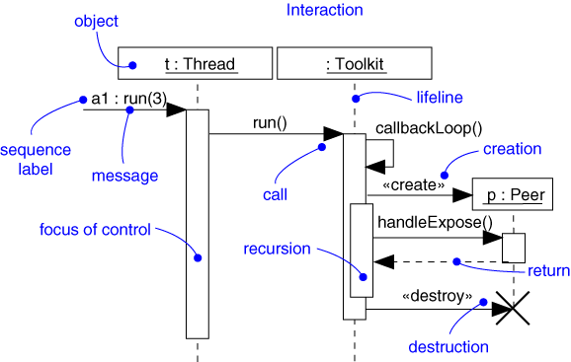
Sequence Diagram
Captures dynamic behavior (time-oriented)

Slide 35
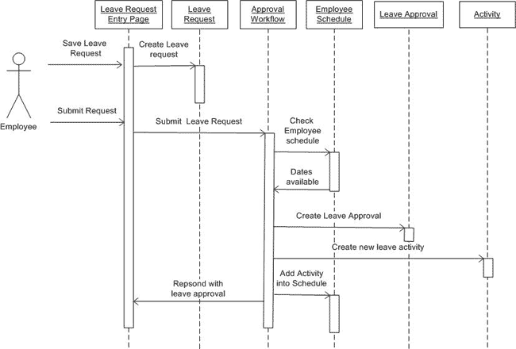
Sequence Diagram

Slide 36
Sequence Diagram
Captures dynamic behavior (time-oriented)
Purpose
  Model flow of control
  Illustrate typical scenarios

Slide 37
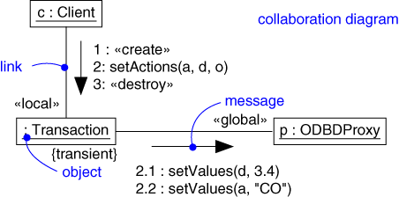
Collaboration Diagram
Captures dynamic behavior (message-oriented)

Slide 38
Collaboration Diagram
Captures dynamic behavior (message-oriented)
Purpose
  Model flow of control
  Illustrate coordination of object structure and control

Slide 39
Collaboration Diagram: Example
  A collaboration diagram displays object interactions organized around objects and their links to one another
course form :
CourseForm
1: set course info
2: process
: Registrar
3: add course
aCourse :
theManager :
CurriculumManager
Course
4: new course
Notes:
22

Slide 40
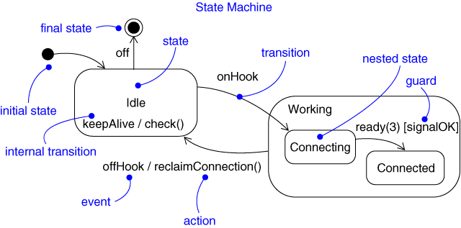
Statechart Diagram
Captures dynamic behavior (event-oriented)

Slide 41
Statechart Diagram
Captures dynamic behavior (event-oriented)
Purpose
  Model object lifecycle
  Model reactive objects (user interfaces, devices, etc.)

Slide 42
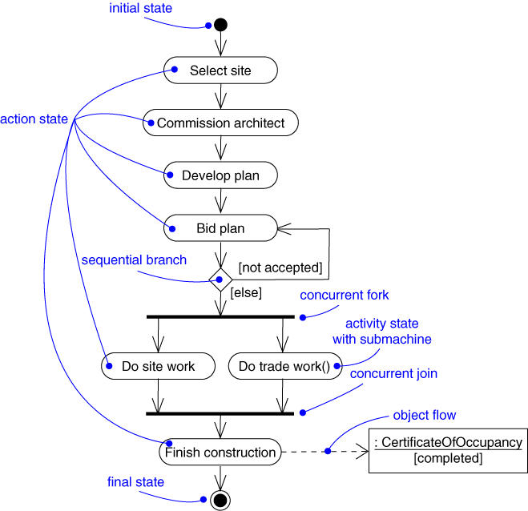
Activity Diagram
Captures dynamic behavior (activity-oriented)

Slide 43
Summary: the UML
  An industry standard for analysis and design of object-oriented systems
    based on extensive experience and best practices
    gaining rapid acceptance (training, tools, books)
  Comprises:
    set of modeling concepts
    graphical notation
  Concepts are organized into diagram types
    class, state machine, collaboration, use case, sequence, activity, component, deployment
  The UML can be used in many different domains to capture domain-specific concepts and ideas

Slide 44
Exercise 1
Choosing a domain that you know deeply
Propose a software project to apply for this domain.
  Project’s name
  Explain the present condition of the domain (functions, fields, people).
  Giving the company/organization/private’s requirements.
At least 2 pages
Do it as detailed as possible

